Slide 1
Find Me
Introduction to
Software Engineering
Group 3
Version 27.09

Slide 2
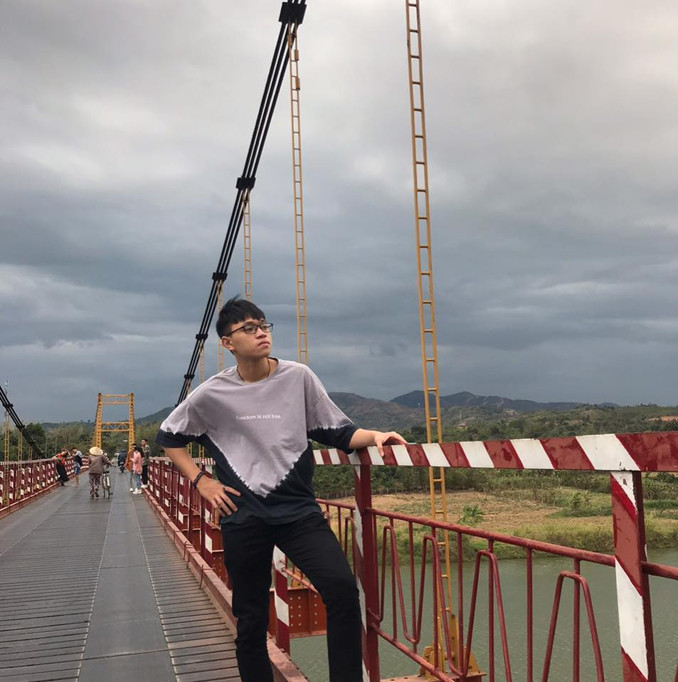

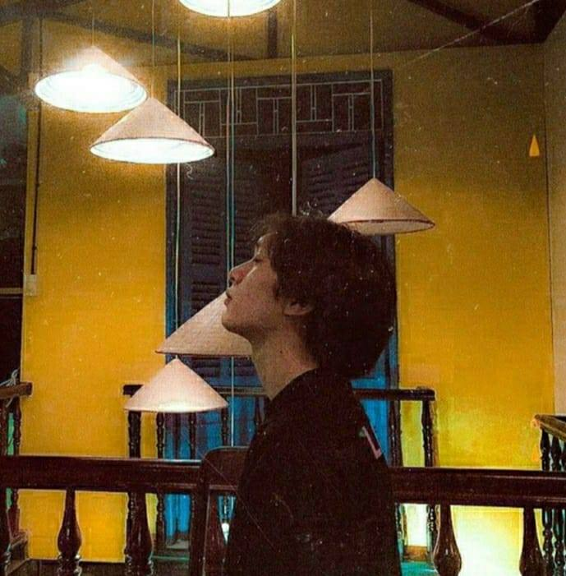
Who Are We?
Tạ Minh Nhật
SE140165
Mobile: 0963179140
Email: minhnhat3105@gmail.com
FB: facebook.com/nhat.ta.000/
Nguyễn Thị Thanh Trúc
SE140219
Mobile: 0902829793
Email: trucnttse140219@fpt.edu.vn
FB: facebook.com/truc178/
“Có cố gắng mới có thành công.”
Quang Hòa
SE130608
Mobile: 0988782805
Email: st.qhoa.99@gmail.com
FB: fb/st.killerd
“Quyết tâm nuôi tóc dài.”
Vũ Thị Thùy Linh
SE140214
Mobile: 0376793093
Email: linhvu263@gmail.com
FB: facebook.com/lyk.vu.9/
“Sống sao để không phải hối tiếc.”
Vũ Lâm Huy
SE140164
Mobile: 0366742484
Email: huyv46@gmail.com
FB: fb/huy.vu
“Ra xã hội làm ăn bươn chải, liều thì ăn nhiều, không liều thì ăn ít.
Muốn thành công thì phải chấp nhận trải qua đắng cay ngọt bùi.”
“Học, học nữa, học mãi, rớt,…. học lại.”
Find Me/FPT University

Slide 3
Agenda
01
Background
Operational Concepts
(What is it?)
02
03
Basic Layouts
Lifecycle Plan
04
05
Conclusion
Find Me/FPT University

Slide 4

01
Background
Find Me/FPT University

Slide 5
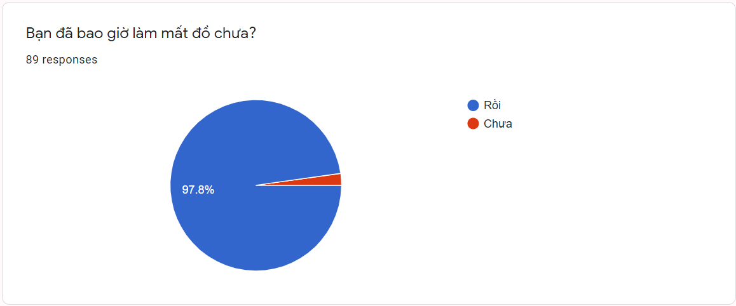
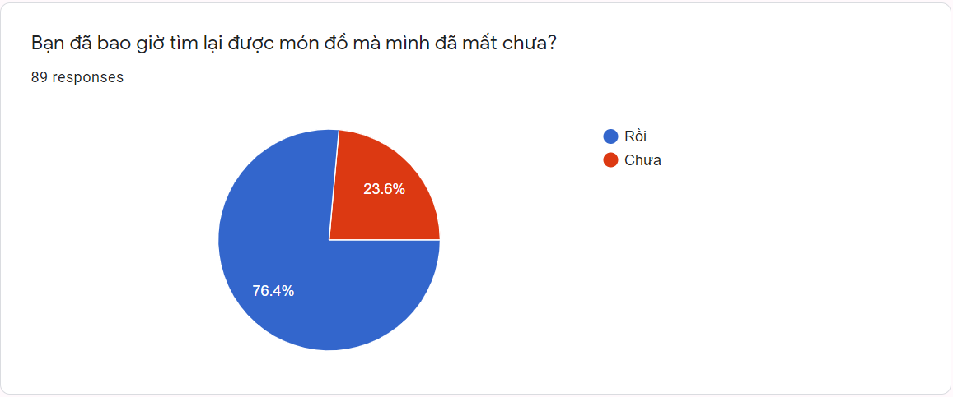
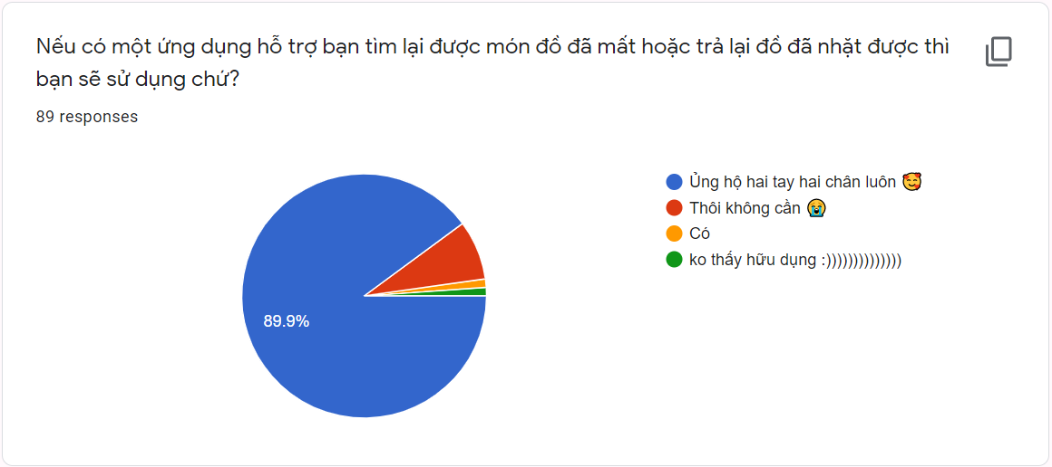
01
Background
Find Me/FPT University

Slide 6
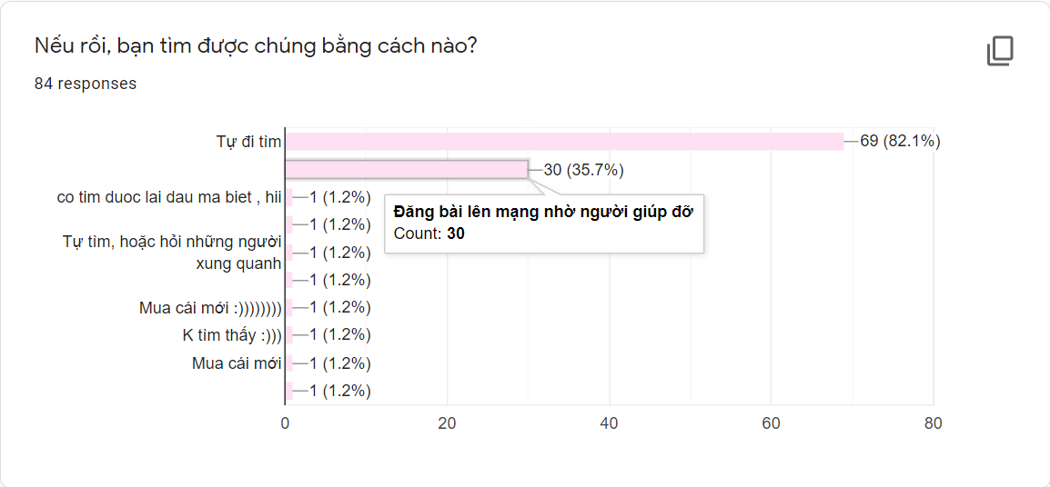
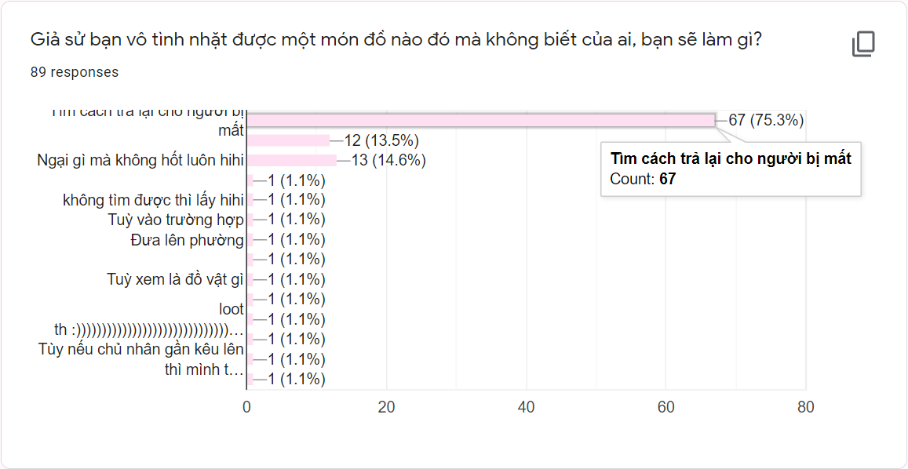
01
Background
Find Me/FPT University

Slide 7
01
Background
Currently, busy work, hustle life makes people tend to "run away" - just joking, that is because they are too in a hurry to sometimes forget or drop things in public. We saw that so we decided to create a generic app for users to use to aid with search.
FindMe's purpose is to help us have an application that can connect a lost and retrieved person. When you find or lose an item and you want to publish an item, where to search, this is the purpose of the application created.
Find Me/FPT University

Slide 8
02
Operational Concepts (What is it?)
Find Me/FPT University

Slide 9


02
Operational Concepts (What is it?)
Found
Return
Find Me/FPT University

Slide 10
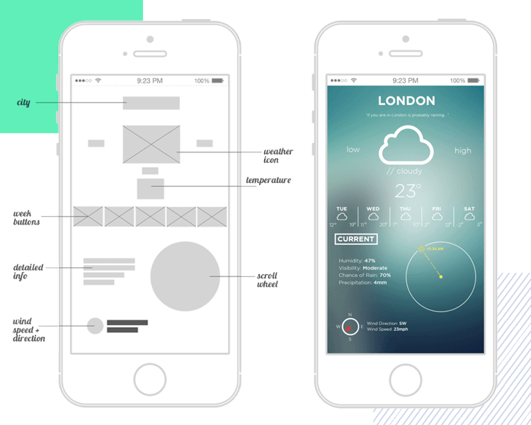
03
Basic Layouts
Find Me/FPT University

Slide 11
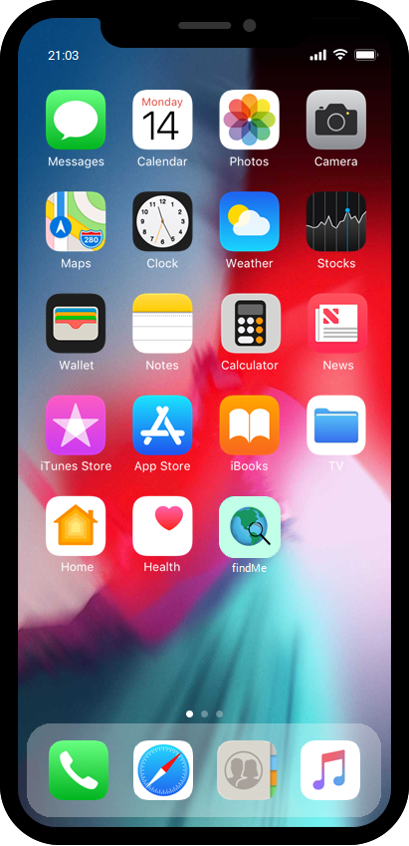
03
Basic Layouts
Main Screen
Find Me/FPT University

Slide 12
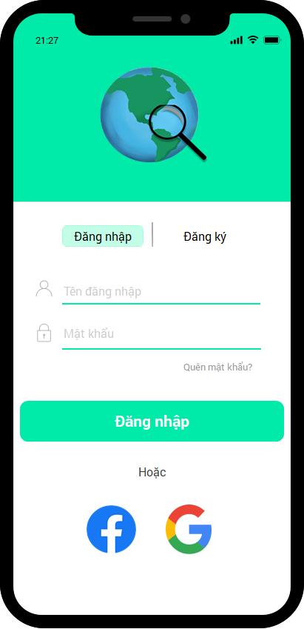
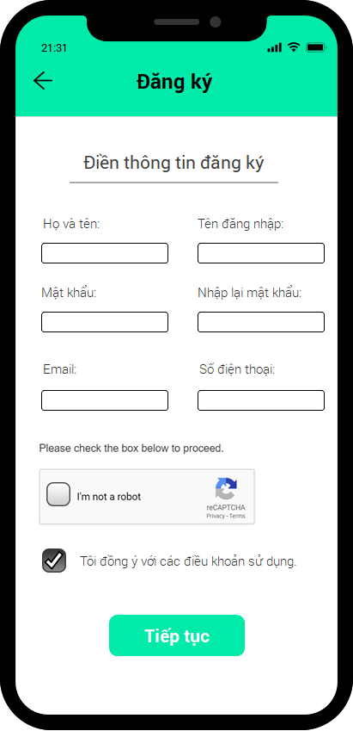
03
Basic Layouts
Sign In
Sign Up
Find Me/FPT University

Slide 13
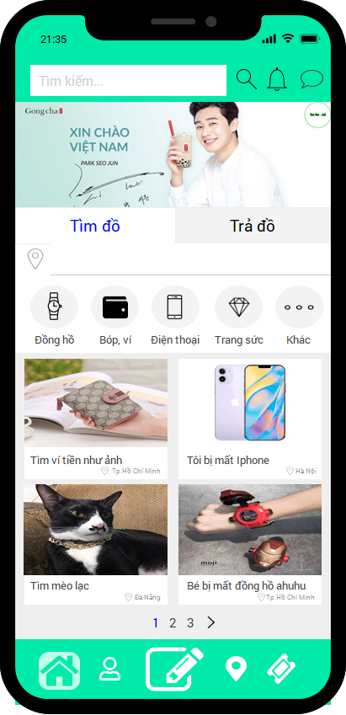
03
Notification
Basic Layouts
Searching
Chat
Advertisement
Options
Located
Nhập vị trí…
Categories suggestion
Newsfeed
Home
Upload Newsfeed
Home
Rewards
Find Me/FPT University
Profile
Map

Slide 14
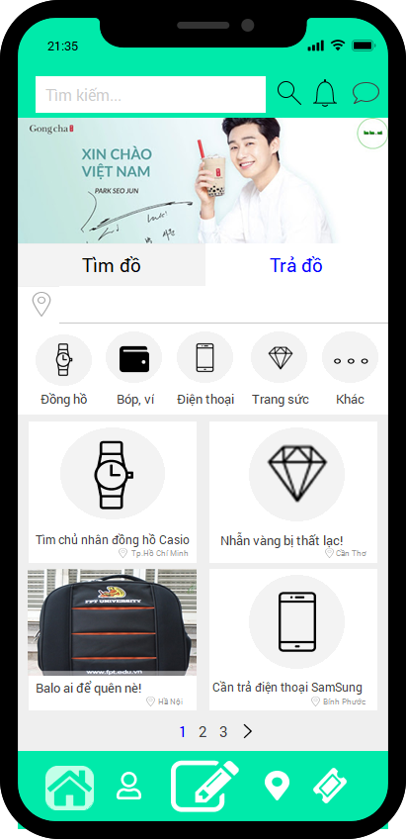
03
Basic Layouts
Nhập vị trí…
Home
Find Me/FPT University

Slide 15
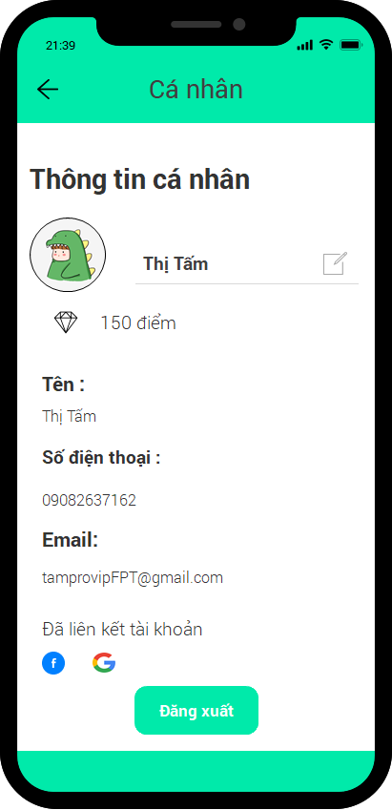
03
Basic Layouts
Profile
Find Me/FPT University

Slide 16
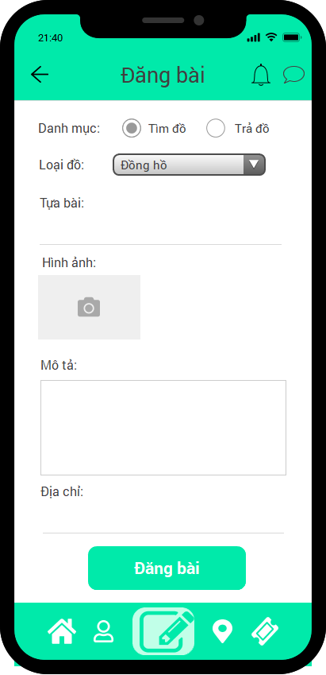
03
Basic Layouts
Upload newsfeed
Find Me/FPT University

Slide 17
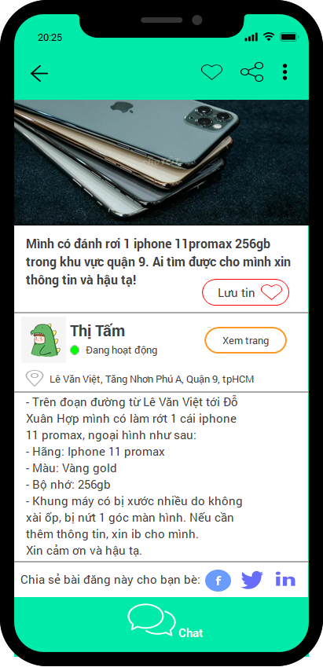
03
Basic Layouts
Content
Find Me/FPT University

Slide 18
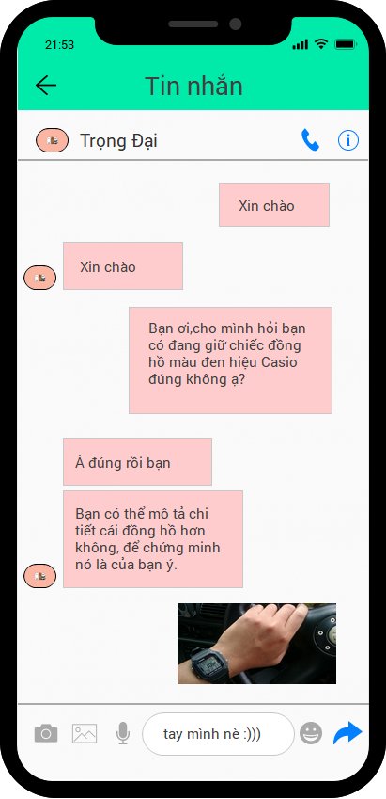
03
Basic Layouts
Chat
Find Me/FPT University

Slide 19
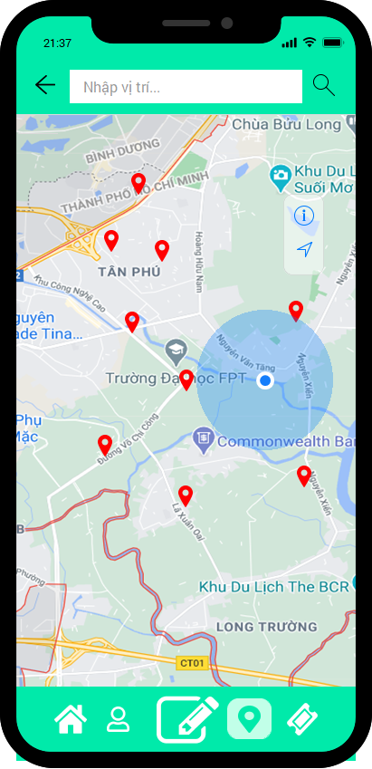
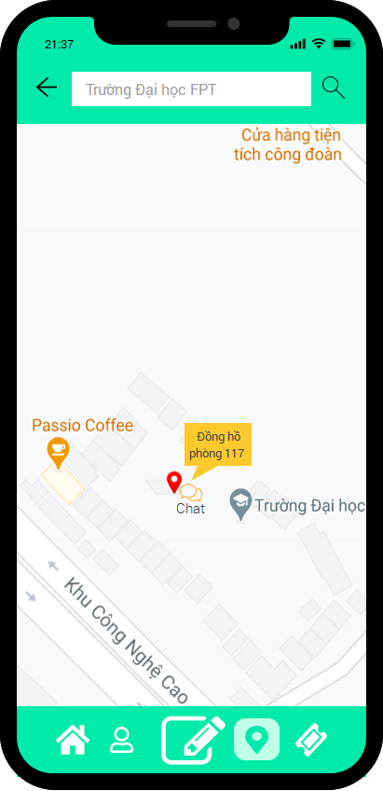
03
Basic Layouts
Map
Find Me/FPT University

Slide 20
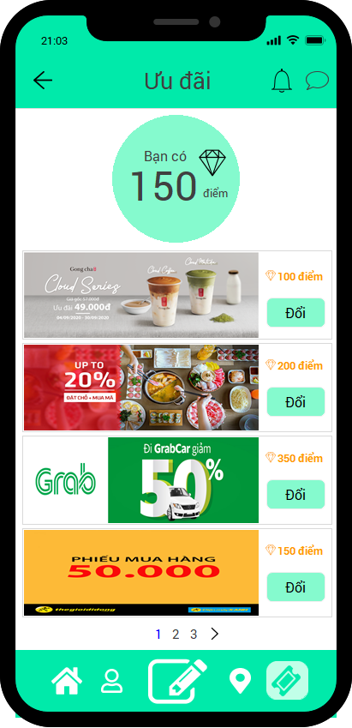
03
Basic Layouts
Rewards
Find Me/FPT University

Slide 21
04
Lifecycle Plan
Find Me/FPT University

Slide 22
04
Lifecycle Plan
Initiation and Requirement Analysis
01
02
Execution
Technical Specifications
03
04
Designing the App
Development
05
06
App Testing And Debugging
Launch
07
08
Monitoring
Find Me/FPT University

Slide 23
5
Conclusion
Find Me/FPT University

Slide 24
05
Conclusion
We know that there are a lot of people who’s very busy, so they sometimes forget or drop their personal item
Find Me is made for find and return everythings by connect people, then give a solution to help them find their things
FindMe is FREE!
Find Me/FPT University

Slide 25
References
Slide template: inspired by http://www.free-power-point-templates.com
Slide instructor by Giao Lang
Mobile apps : Chotot, Grab, Traista
Find Me/FPT University

Slide 26

THANK YOU
Thanks to the Internet for the slide template and images

